Slide 1
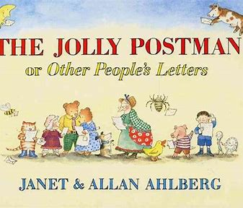
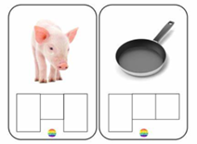
 | Reception Knowledge Organiser – Spring 2025
 | Week 1 | Week 2 & 3 | Week 4 & 5 | Week 6 & 7 | Week 8 & 9 | Week 10 & 11 | Week 12
Topics | Winter | Antarctic Animals (Penguins) Rainforest Animals (Parrots) | People Who Help Us | Transport | Under The Sea | Spring | Easter
Skills Covered | Observing and identifying changes in seasons. Reciting and understand numbers to 20. Identifying different emotions. | Writing captions and short sentences using known phonics. Using a variety of materials for a purpose. Developing fluency with different movements. | Thinking of and ask questions to an unfamiliar adult. Manipulation and joining of materials to create a 3D model. Writing for a purpose. | Identifying differences in old and new. Understanding the composition of 10. Identifying own emotions and self-worth. | Developing body strength and balance. Writing captions and short sentences using known phonics. Identifying similarities and differences in habitats. | Recognising different festivals and how they are celebrates. Working collaboratively using different techniques. Solving problems involving doubling and halving. | Recognising the differences in a variety beliefs. Developing coordination. Retelling a story.
Communication and Language, Literacy
Key Learning Objectives | Diagrams and Key Vocab | Continuous Provision
To spell words by identifying sounds. To write short sentences with known sounds. | Winter, rhyme, poetry, Antarctic, non-fiction, facts, title, labels, occupations, invitation, transport, creatures, Spring, sunflower, Easter. | Lost poster Invitation Captions Describing images Labelling
Expressive Arts and Design
Key Learning Objectives | Key Vocab | Continuous Provision
To use a variety of materials for artistic effect. To manipulate materials to achieve a planned effect. To use colour for a purpose. | Twisting, scrunching, tear, joining, colour names, snowflake, dabbers, sculpture, light and dark. collaborate, Yayoi Kusama, carp lanterns, porthole. | 3D models Group creations Collage Exploring different materials Junk modelling

Slide 2
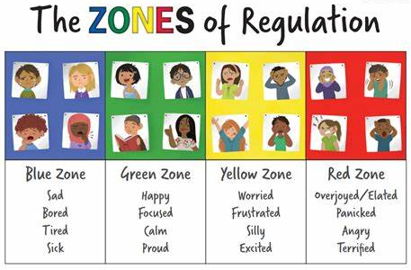
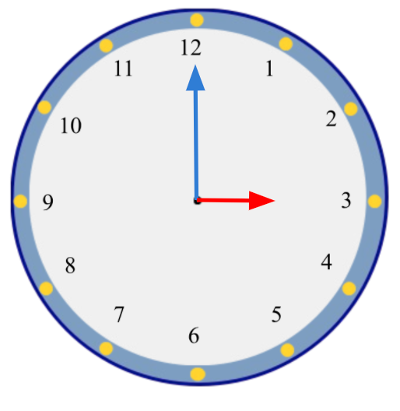
Personal, Social and Emotional Development
Key Learning Objectives | Diagrams and Key Vocab | Continuous Provision
To explore and identify different emotions. To begin to understand how to manage our emotions. To understand what perseverance means. | Happy, angry, sad, surprised, worried, scared, excited. | Circle time discussions. Roleplaying a variety of scenarios.
Mathematics
Key Learning Objectives | Diagrams and Key Vocab | Continuous Provision
To talk about, copy, repeat and create repeating patterns with pictures, objects and numbers. To find the total of two groups by counting. To understand subtraction as taking away or counting back. To solve problems including doubling and halving. To recognise time to the hour. To understand relative size of quantities. | Subtract, take away, minus, addition, add, total, more, less, double, half, odd even, minute, hour, o’clock. | Exploring patterns Using manipulatives, including: numicon, counting objects, tens frame and number lines. Clocks and timers.
Understanding the World
Key Learning Objectives | Key Vocab | Continuous Provision
To explore the effect of seasons. To identify and explore different animals and discuss their habitats. To identify and compare things from the past. | Winter, Spring, global warming, pollution, Antarctica, rainforest, penguin, parrots, aquatic, habitat, occupations, vehicle, transport. | Season walks. Exploring non-fiction books. Asking questions to visitors. Sorting old and new.
Physical Development
Key Learning Objectives | Key Vocab | Continuous Provision
To develop overall body strength, balance, coordination and agility. To begin to combine movements with ease and fluency. To develop and refine a range of ball skills. To participate in a game safely. | Netball, rugby, pass, football, dribble, throwing, passing, kicking, catching, quoits, batons. Apparatus, travel, over, under, around, high , low, climb, balance, movement, skip, hop run, twirl, spin. | Gross motor Passing a rugby ball Ribbons, bikes, obstacle course, building with large apparatus, climbing, Fine motor Tweezer, threading, pinching, playdough, pencil grip.

