Slide 1
 | Reception Knowledge Organiser – Autumn
 | Week 1 | Week 2 | Week 3 | Week 4 | Week 5 | Week 6 | Week 7 | Week 8 | Week 9 | Week 10 | Week 11/12 | Week 13/14/15
Topics | Starting School | Little Red Riding Hood | Jack and the Beanstalk | The Enormous Turnip | The Little Red Hen | The Billy Goats Gruff | The Gingerbread man | Bonfire Night | Diwali | Light and Dark – Nocturnal animals | Planets | Christmas
Skills Covered | Listening to and discussing stories. Understanding rules and boundaries Changing independently | Recognising numerals 1 to 5. Talking about different areas. Choosing colours purposfully | Retelling stories Talking to others to solve conflicts. Moving in different ways. | Writing sounds and simple words. Describing changes over time. Recording using marks that can be explained | Counting up to 4 objects. To talk about how things chage Talking about responsibilities | Hearing and saying initial sounds. Counting actions or objects that cannot be moved. To safely use indoor apparatus. | Counting objects to 10. Describing the natural environment. Selecting and changing colour for a desired effect | Identifying rhyming words. Exploring feelings and emotions. Catching skills. | Selecting numerals to represent 1-5. Discussing special events Using materials for a desired effect. | Recognising and writing initial sounds. To understand ways to share Identifying differences within the natural world. | Estimating amounts. Using materials to create a model To link movements together | Forming letters to make words Talking about family celebrations. Explaining changes within the environment.
Communication and Language, Literacy
Key Learning Objectives | Diagrams and Key Vocab | Continuous Provision
To listen to and discuss stories. To hear and say initial sounds in words. To begin to form letters in words. | Red riding hood, Grandma, wolf, beanstalk, giant, swan, harp, enormous, turnip, Autumn, harvest, troll, gingerbread, bonfire, fireworks, celebrations, sparklers, Rama, Sita, Diwali, diva lamp, nocturnal, planets. | Initial sound flash cards. Story sacks of traditional tales. Letter formation prompts. CVC writing prompts
Expressive Arts and Design
Key Learning Objectives | Key Vocab | Continuous Provision
To choose colours for a purpose. To use materials to create a desired effect. | Size, shapes, colours, pattern, texture, manipulate, self portrait, baking, bread, dough, glitter, clay. | Playdough modelling. Using a variety of materials including pastels, chalk, charcoal, pencils and paint. Threading Junk modelling Scissor skills

Slide 2
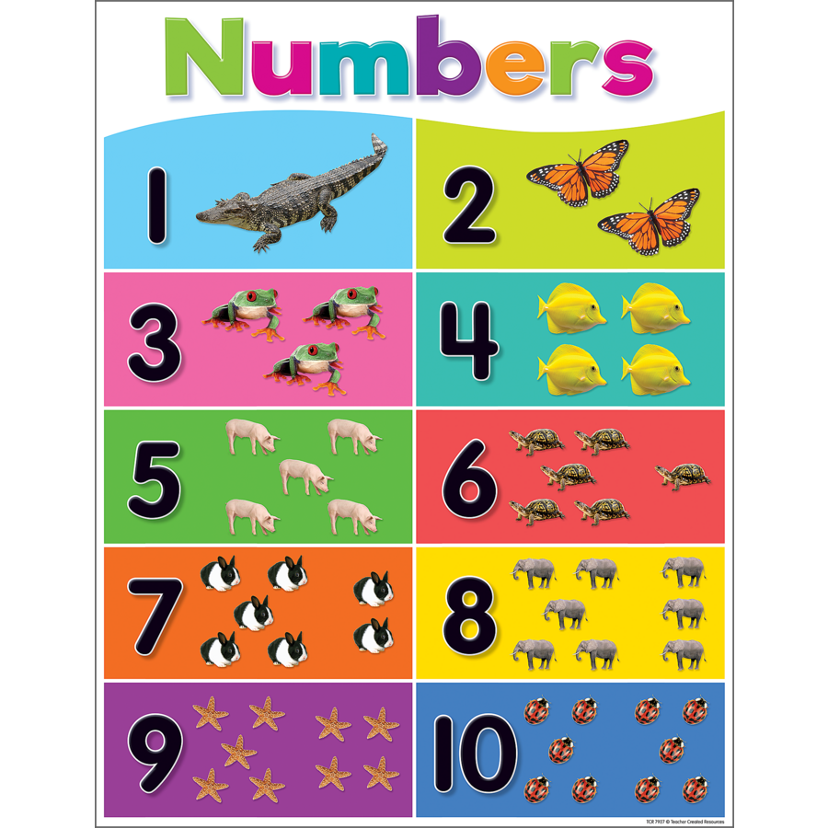
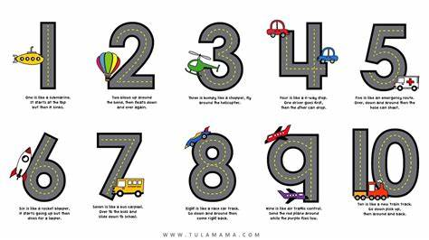
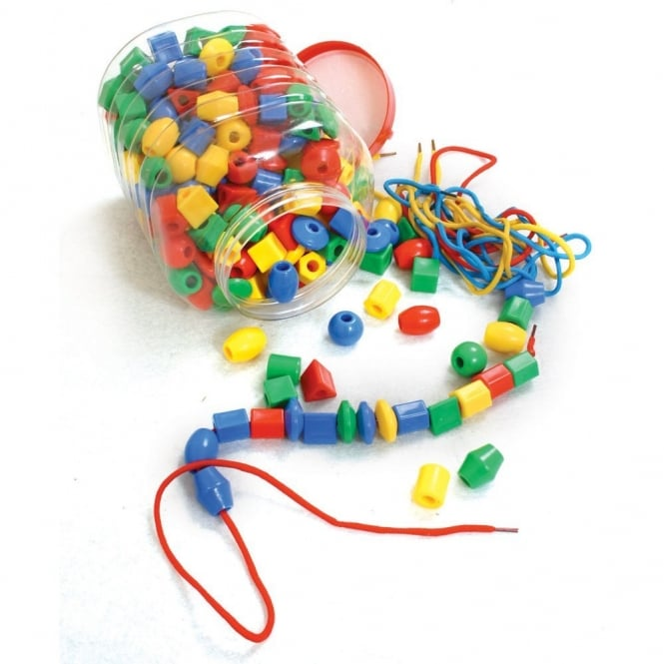
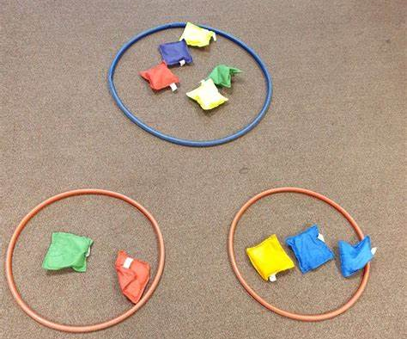
Personal, Social and Emotional Development
Key Learning Objectives | Diagrams and Key Vocab | Continuous Provision
To begin to understand why we have rules and boundaries. To talk about responsibilities around school. To begin to explore how we are feeling. | Rules, boundaries, safe, families, similarities, differences, unique, compromise, responsibility, teamwork, vote, rights, importance, meaningful, personality, fair, unfair, nativity, festivals, celebrations. | Circle time discussions. Worry monster. Games to play in teams/pairs. Roleplaying a variety of scenarios.
Mathematics
Key Learning Objectives | Diagrams and Key Vocab | Continuous Provision
To recognise numerals 1-5. To record sing marks that you can explain. To count actions or objects which can’t be moved. To count objects to 10 and beginning to count beyond 10. To begin to subitise to 5. | Numerals 1 to 10, count, how many, amount, objects, pointing, tallys, formation, subitise, | Using manipulatives, including: numicon, counting objects, number cards. Number formation prompts. Subitising prompts. Dice and counting games.
Understanding the World
Key Learning Objectives | Key Vocab | Continuous Provision
To talk about different areas and their purpose. To talk about how things change To say how people use objects when celebrating special events. | Planting, soil, water, broad bean, vegetables, Autumn, harvest, crops, ingredients, google maps, features, bridge, river, bonfire night, Diwali, Rama, Sita, Religion, Hindu, nocturnal, Christmas, nativity, presents, gifts. | School images, maps Plants growing inside at different stages Vegetables to explore Bonfire images, firework images, Exploration and investigation tuff trays
Physical Development
Key Learning Objectives | Key Vocab | Continuous Provision
To get changed on my own. To safely use the indoor apparatus. To catch a medium sized object To link movements together with confidence. | PE kit, jumping, hopping, skipping, running, quoits, cones, distance, obstacle, balance, beanbags, hoops, parachute, throw, catch. | Gross motor Apparatus Throwing quoits, beanbags Catching beanbags, tennis balls, large balls Fine motor Tweezer, threading, pinching, playdough, pencil grip.

